Slide 1
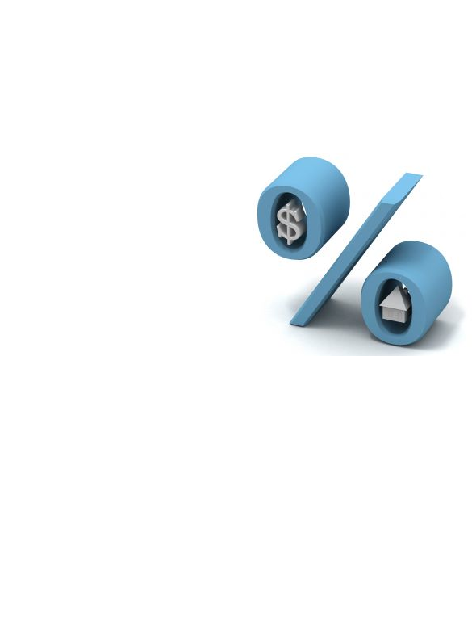
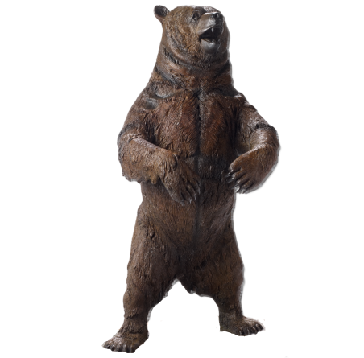
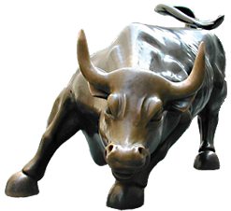
2017 Forecast
Presented By Doug Haldeman
Notes:
Batting Average, Information vs. Wisdom, Borrower Mindset

Slide 2
2016 Predictions
Forecasted the 10-year Treasury Note Yield would drop below 2% - The 10-year began the year at 2.245%, and then dropped to 1.325% on July 6th.
Forecasted home price appreciation would be 5% - 6% - Actual was up 6.2%.
Forecasted Stocks, as measured by the S&P 500, would decline by 300 points - Stocks did decline by 200 points in February from the start of the year, but then did rally into the end of the year due to optimism from the Trump Election.
Forecasted that the Fed would hike only once, while everyone else was forecasting 4 rate hikes. Our forecast of just 1 hike was right on target.

Slide 3
2017 Dynamics
Trump Administration
Inflation pressures remain very tame, but may start to heat up
Home inventory levels remain very low
Modestly higher Rates – Refinances starting to slow
US Manufacturing sector is still lackluster
The Fed is indicating three rate hikes

Slide 4
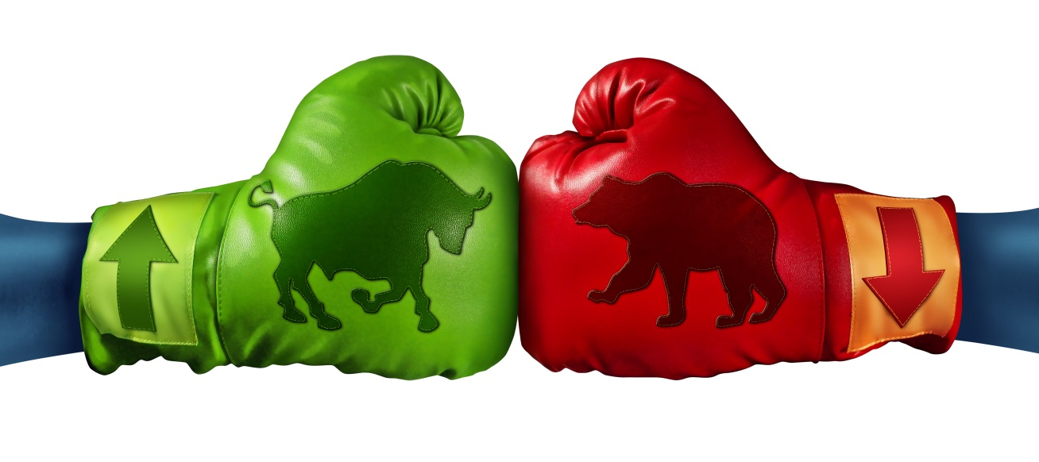
Stocks
Stocks appear toppy and a bit vulnerable. We are entering the new year with extremely high investor optimism. This is often a dangerous sign.
Prediction: We feel there could be a potential for a Stock market correction. While 20,000 on the Dow seems inevitable, there could be a pullback after breaking through it.
When the Dow broke above 1,000, Stocks pulled back shortly thereafter and it took 10 years to break above it again
When the Dow broke above 10,000, Stocks pulled back shortly thereafter and it took 9 years to break above it again.
We are not saying this will happen again, but often times these milestone levels are tough ceilings.

Slide 5
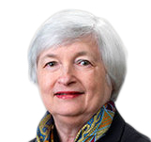
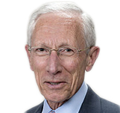
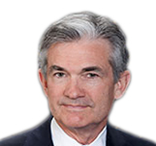
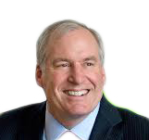
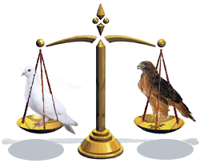
Changing of the Guard
2016
The Fed Dove Hawk Scale
(5)
Dove Centrist Hawk
(2)
(3)
NY Fed President
William Dudley
Fed Chair
Janet Yellen
Vice Chair
Stanley Fischer
Cleveland Fed Pres.
Loretta Master
Kansas City Fed Pres.
Esther George
Fed Governor
Daniel Tarullo
Fed Governor
Lael Brainard
Fed Governor
Jerome Powell
St. Louis Fed Pres.
James Bullard
Boston Fed President
Eric Rosengren

Slide 6
Changing of the Guard
2017
The Fed Dove Hawk Scale
(5)
Dove Centrist Hawk
(4)
(1)
Fed Chair
Janet Yellen
Fed Governor
Daniel Tarullo
Vice Chair
Stanley Fischer
Minn Fed Pres.
Neel Kashkari
Philly Fed Pres.
Patrick Harker
NY Fed President
William Dudley
Chicago Fed Pres.
Charles Evans
Fed Governor
Jerome Powell
Dallas Fed Pres.
Robert Kaplan
Fed Governor
Lael Brainard

Slide 7
The Fed
Fed Members forecasting three rate hikes
Many economists are predicting four rate hikes
Our Prediction: With the new 2017 composition of the Fed, it will be difficult for them to hike 3 or 4 times. And we know how much the Fed likes to drag their feet in hiking. We predict 1-2 Fed Rate hikes.

Slide 8
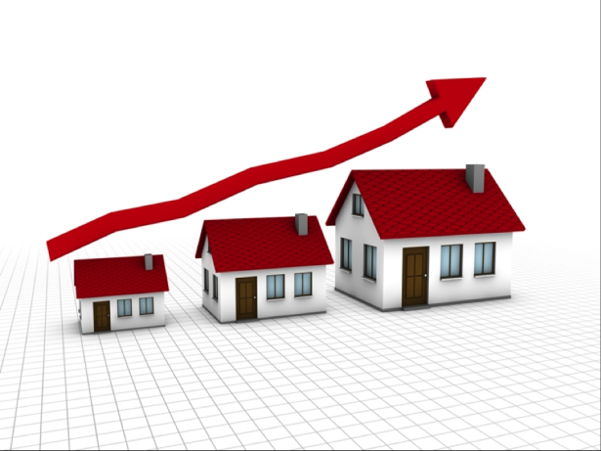
Housing
Low inventory
Rents rising at 4% per year
Modestly Higher Rates – Won’t derail the housing market
Incomes rising at a pace to easily support appreciation
Demand remains strong
Prediction:
5% - 5.5% Appreciation

Slide 9
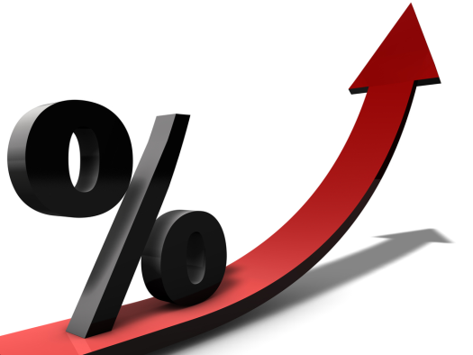
Rates
Inflation is main driver of rates – Rates will move higher, but not astronomically
Global yields will rise and pressure US yields a bit higher
Infrastructure projects under Trump will be financed by selling additional Bonds. This excess supply is a negative for rates.
Prediction: The 10-year Treasury Note Yield will gradually rise towards 3%

Slide 10
Thank You
We hope that the prediction for you is health, happiness, and a year filled with prosperity and lots of laughter.

